Slide 1
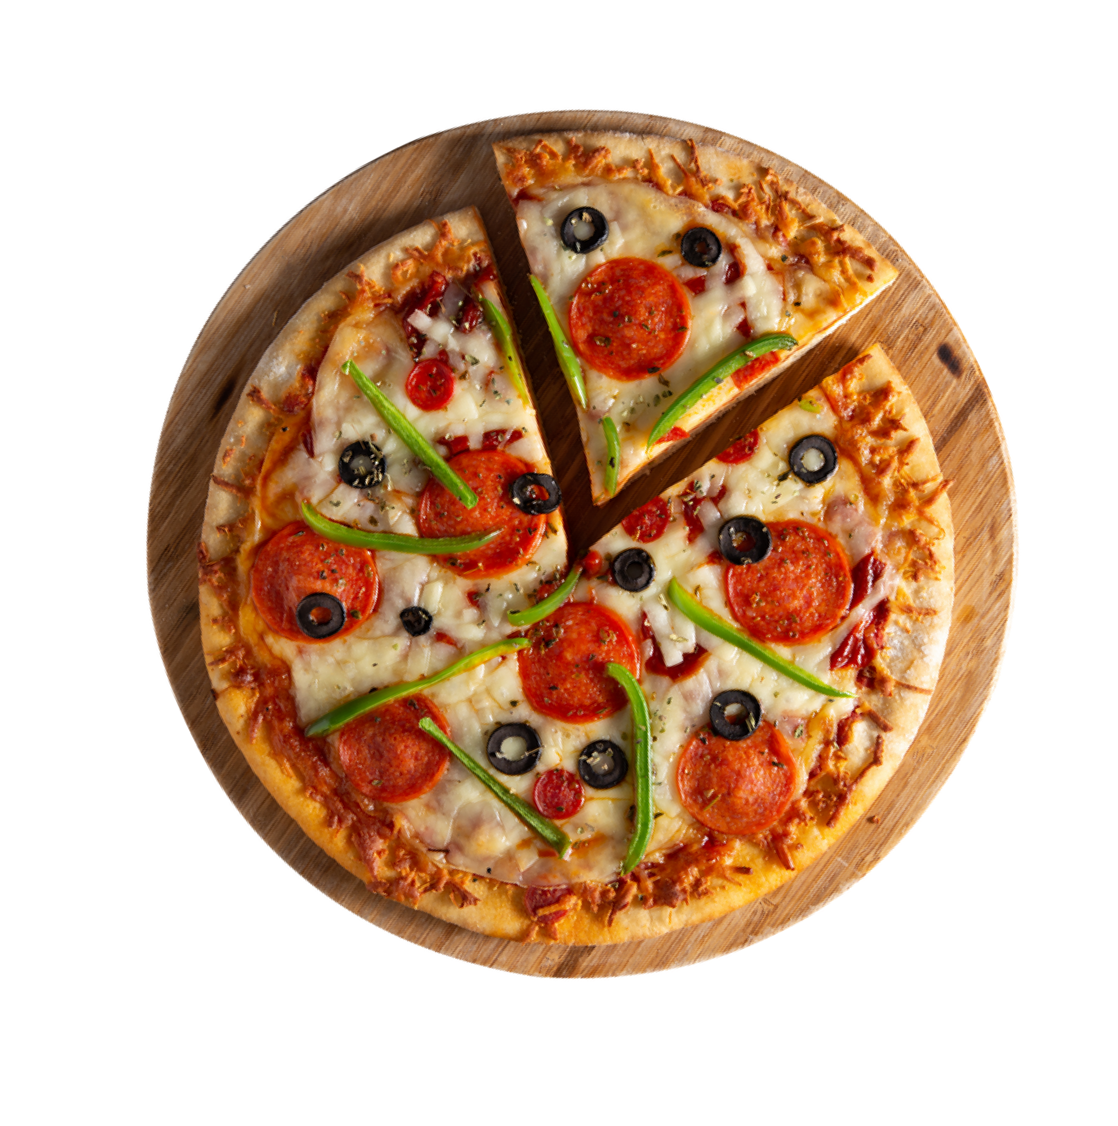
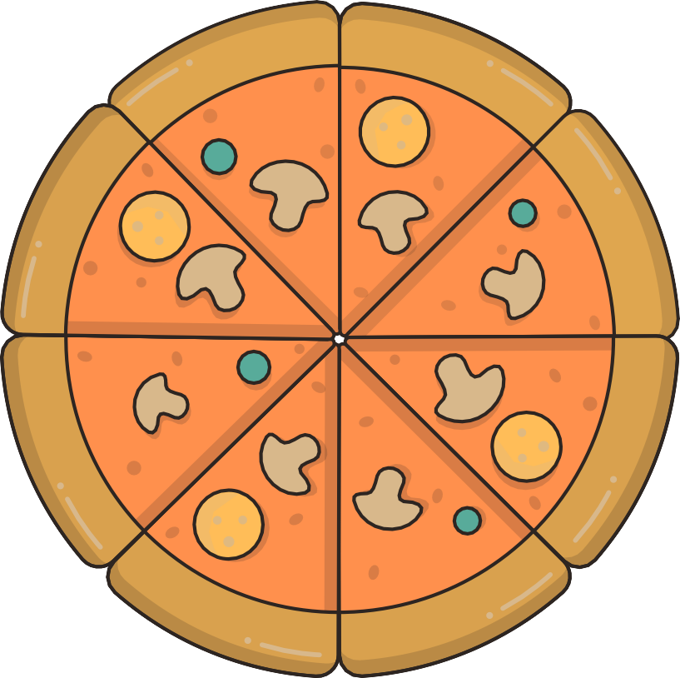
MYSQL PROJECT
PIZZA SALES ANALYSIS
-Reshma Waghmare

Slide 2






Objective
The objective of conducting a pizza sales analysis using MySQL is to comprehensively evaluate and enhance the business's performance by leveraging detailed data insights. This analysis aims to assess overall sales trends, identify the most and least popular pizza varieties, and understand customer purchasing behaviors. By using MySQL to conduct a thorough analysis of pizza sales, the business can make informed decisions that lead to increased efficiency, profitability, and customer satisfaction.

Slide 3






Problem Statement
KPI’S :
Total Revenue
Average Order Value
Total Pizza Sold
Total Orders
Average Pizza Sold per Order.
Highest / Lowest Priced Pizza
Daily / Hourly / Monthly Trend for Total Orders
Percentage of Sales by Pizza Category
Percentage of Sales by Pizza Size
Total Pizzas Sold by Pizza Category
Top 5 / Bottom 5 : Sellers by Quantity
Top 5 / Bottom 5: Sellers by Total Orders
Top 5 / Bottom 5 : Sellers by Revenue

Slide 4



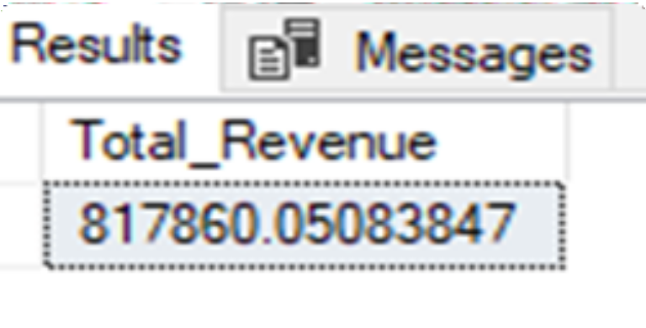
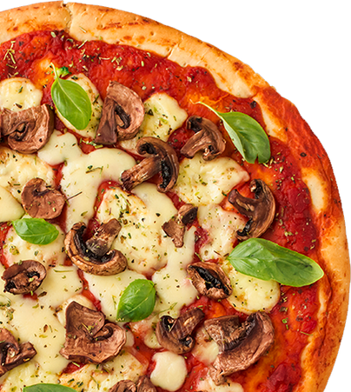
Total Revenue

Slide 5

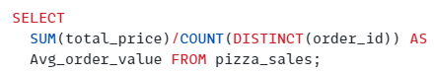

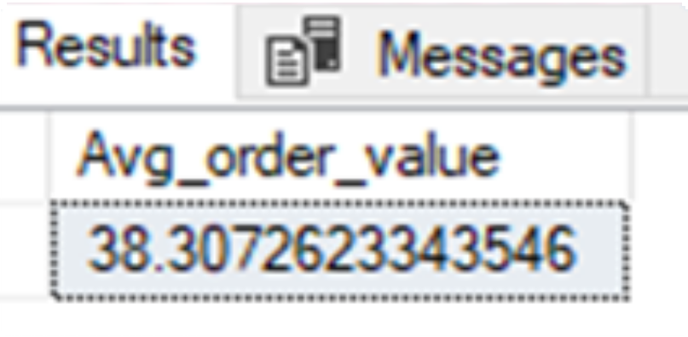
Average Order Value

Slide 6



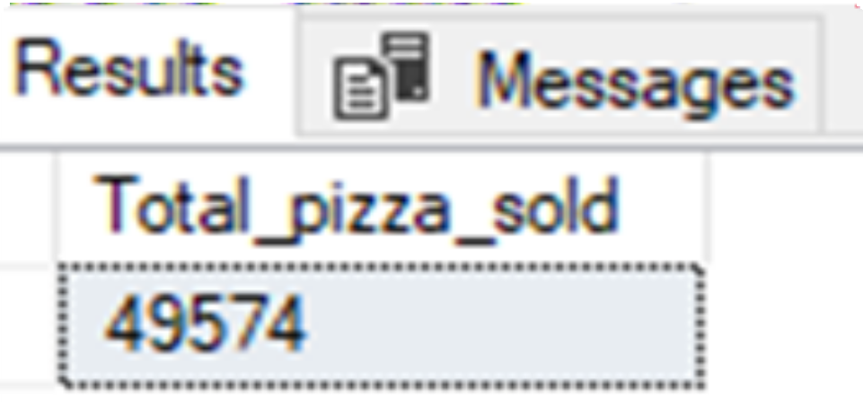
Total Pizza Sold

Slide 7



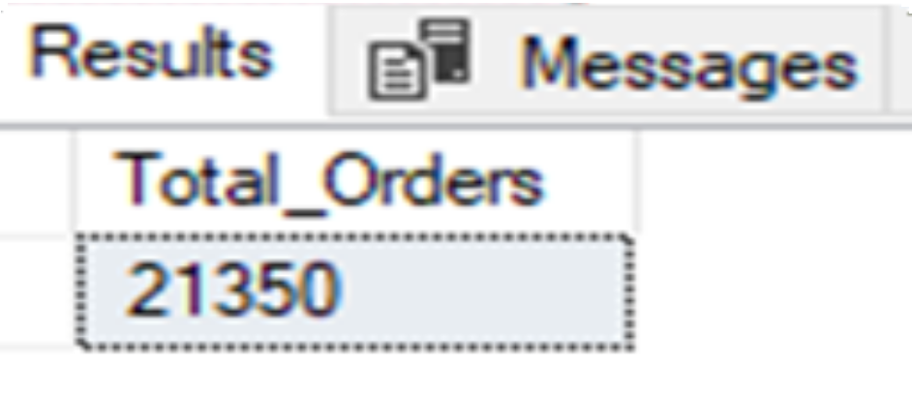
Total Orders

Slide 8


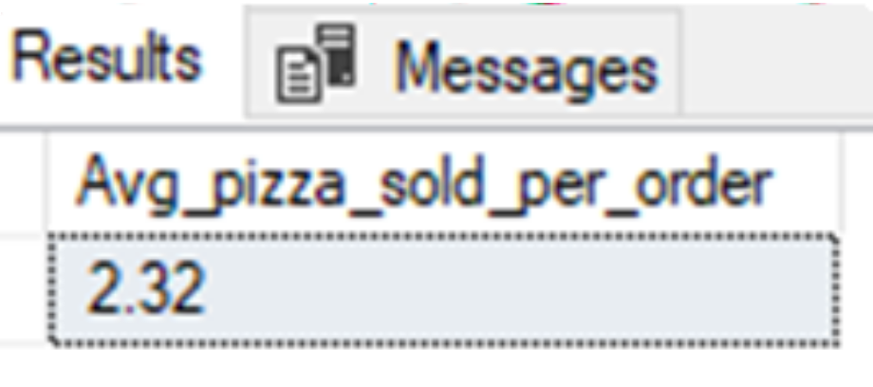
Avg Pizza sold per order

Slide 9
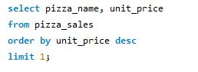
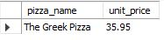
Highest price pizza

Slide 10
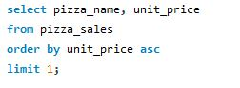
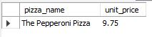
Lowest price pizza

Slide 11

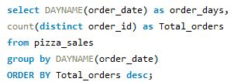

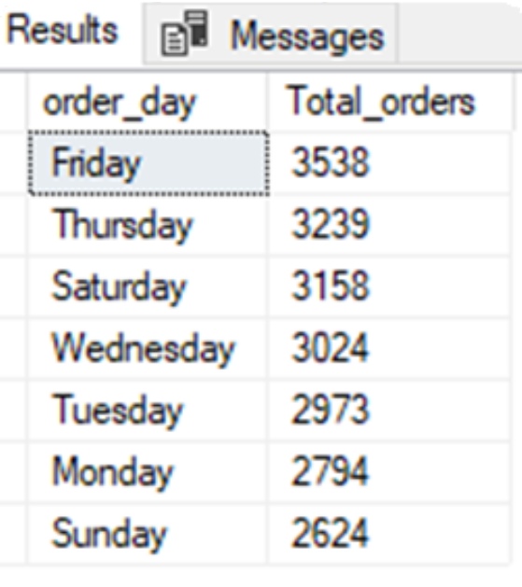
Daily Trend for Total Orders

Slide 12
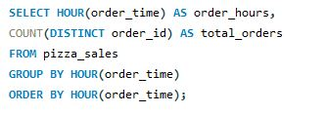
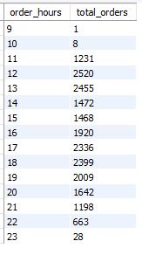
Hourly Trend for Total Orders

Slide 13

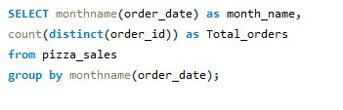

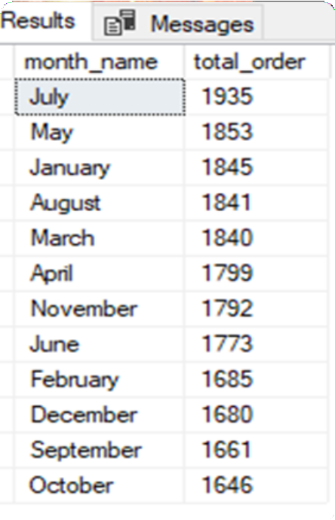
Monthly Trend for Total Orders

Slide 14

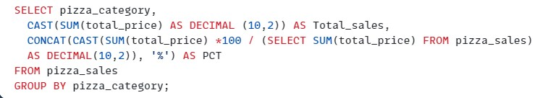

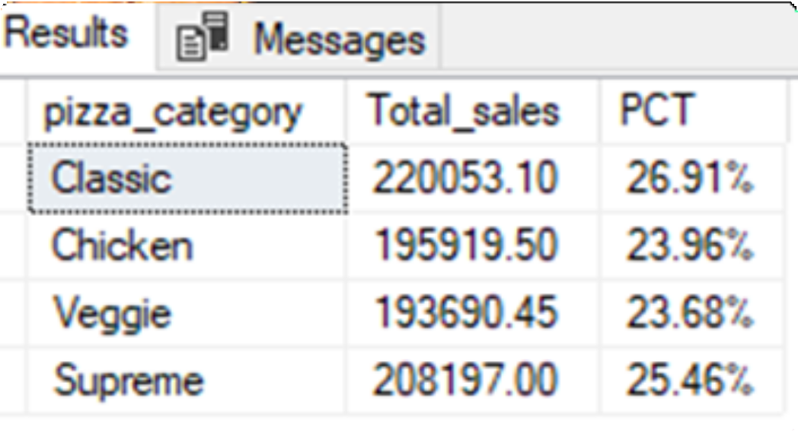
Percentage of sales by Pizza Category

Slide 15

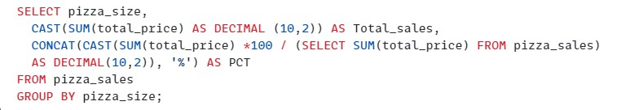

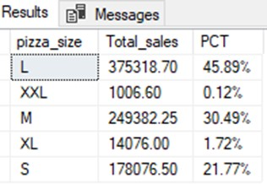
Percentage of sales by Pizza Size

Slide 16

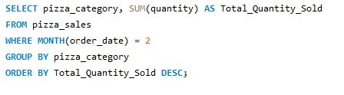

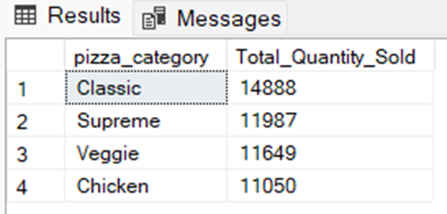
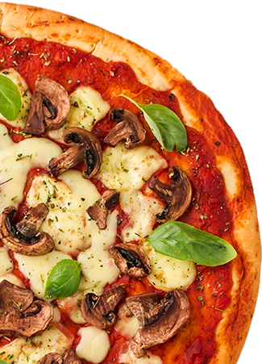
Total pizzas sold by pizza category

Slide 17
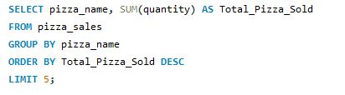
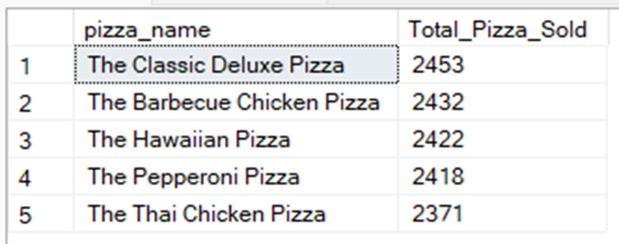
Top 5 best sellers by Quantity

Slide 18
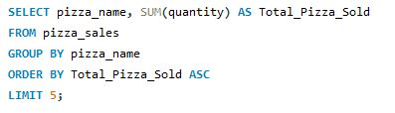
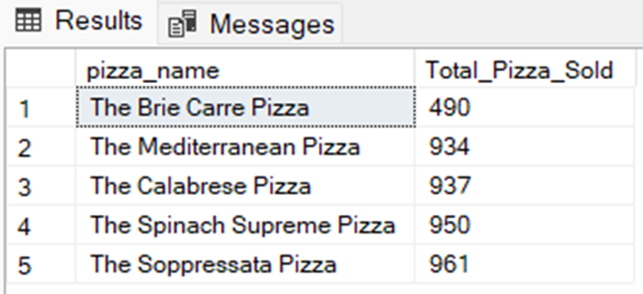
Bottom 5 best sellers by Quantity

Slide 19
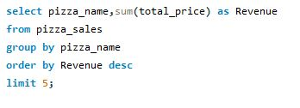
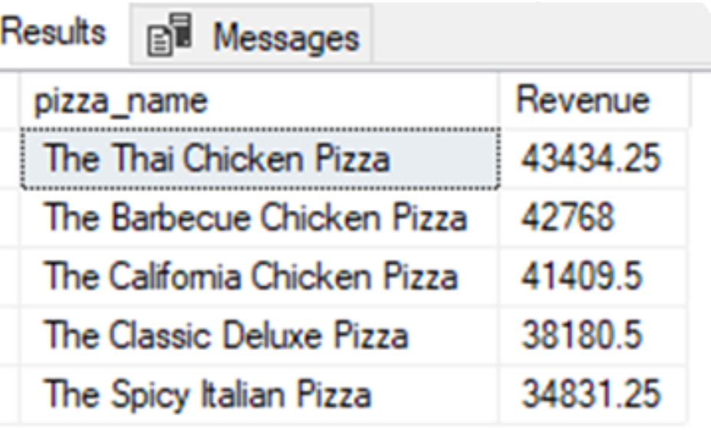
Top 5 sellers by Revenue

Slide 20

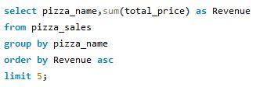

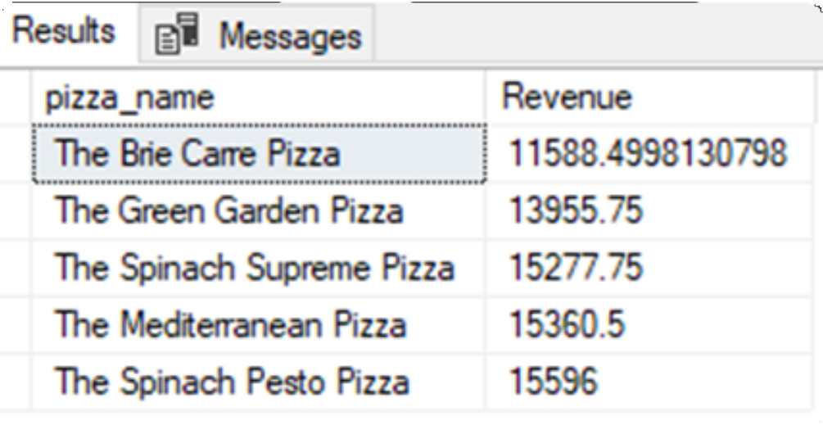
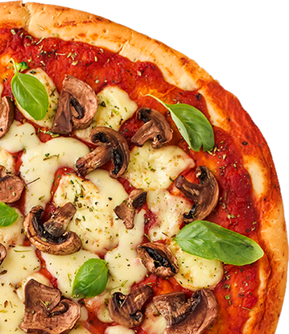
Bottom 5 sellers by Revenue

Slide 21

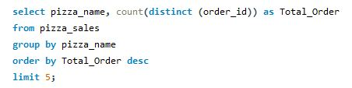

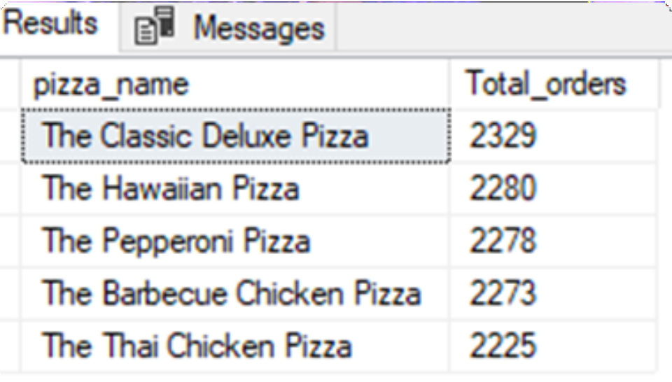
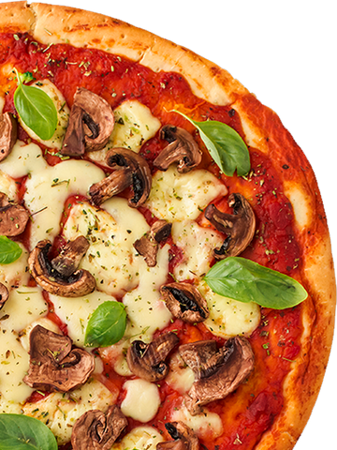
Top 5 sellers by Total Orders

Slide 22

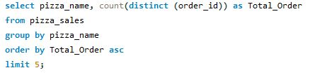
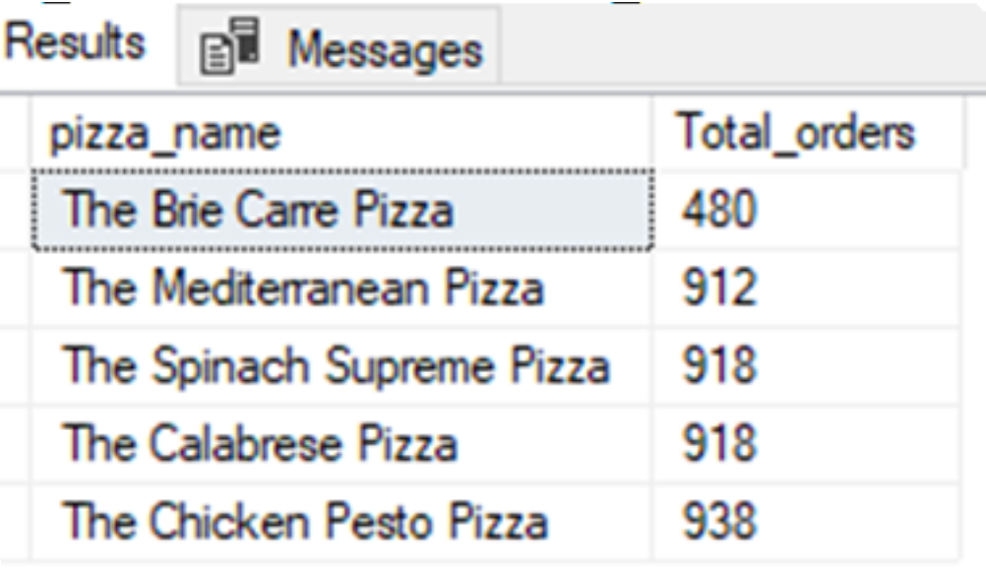
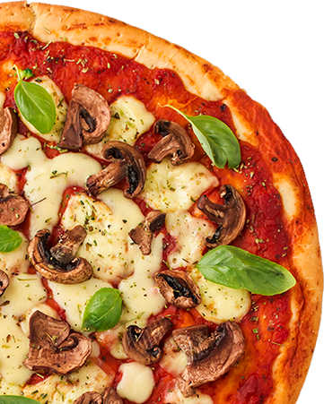
Bottom 5 sellers by Total Orders

Slide 23



Insights
The peak for orders is during weekends, especially on Friday and
Saturday evenings.
The months of May and July record the highest number of orders, while September and October see the lowest. This indicates a trend where summer months have the highest order volume compared to lower orders in winter.
Analyzing sales performance by pizza category reveals that the
Classic Category pizza garners the most sales and total orders.
In terms of pizza size, the majority of people prefer ordering Large size pizzas.

Slide 24
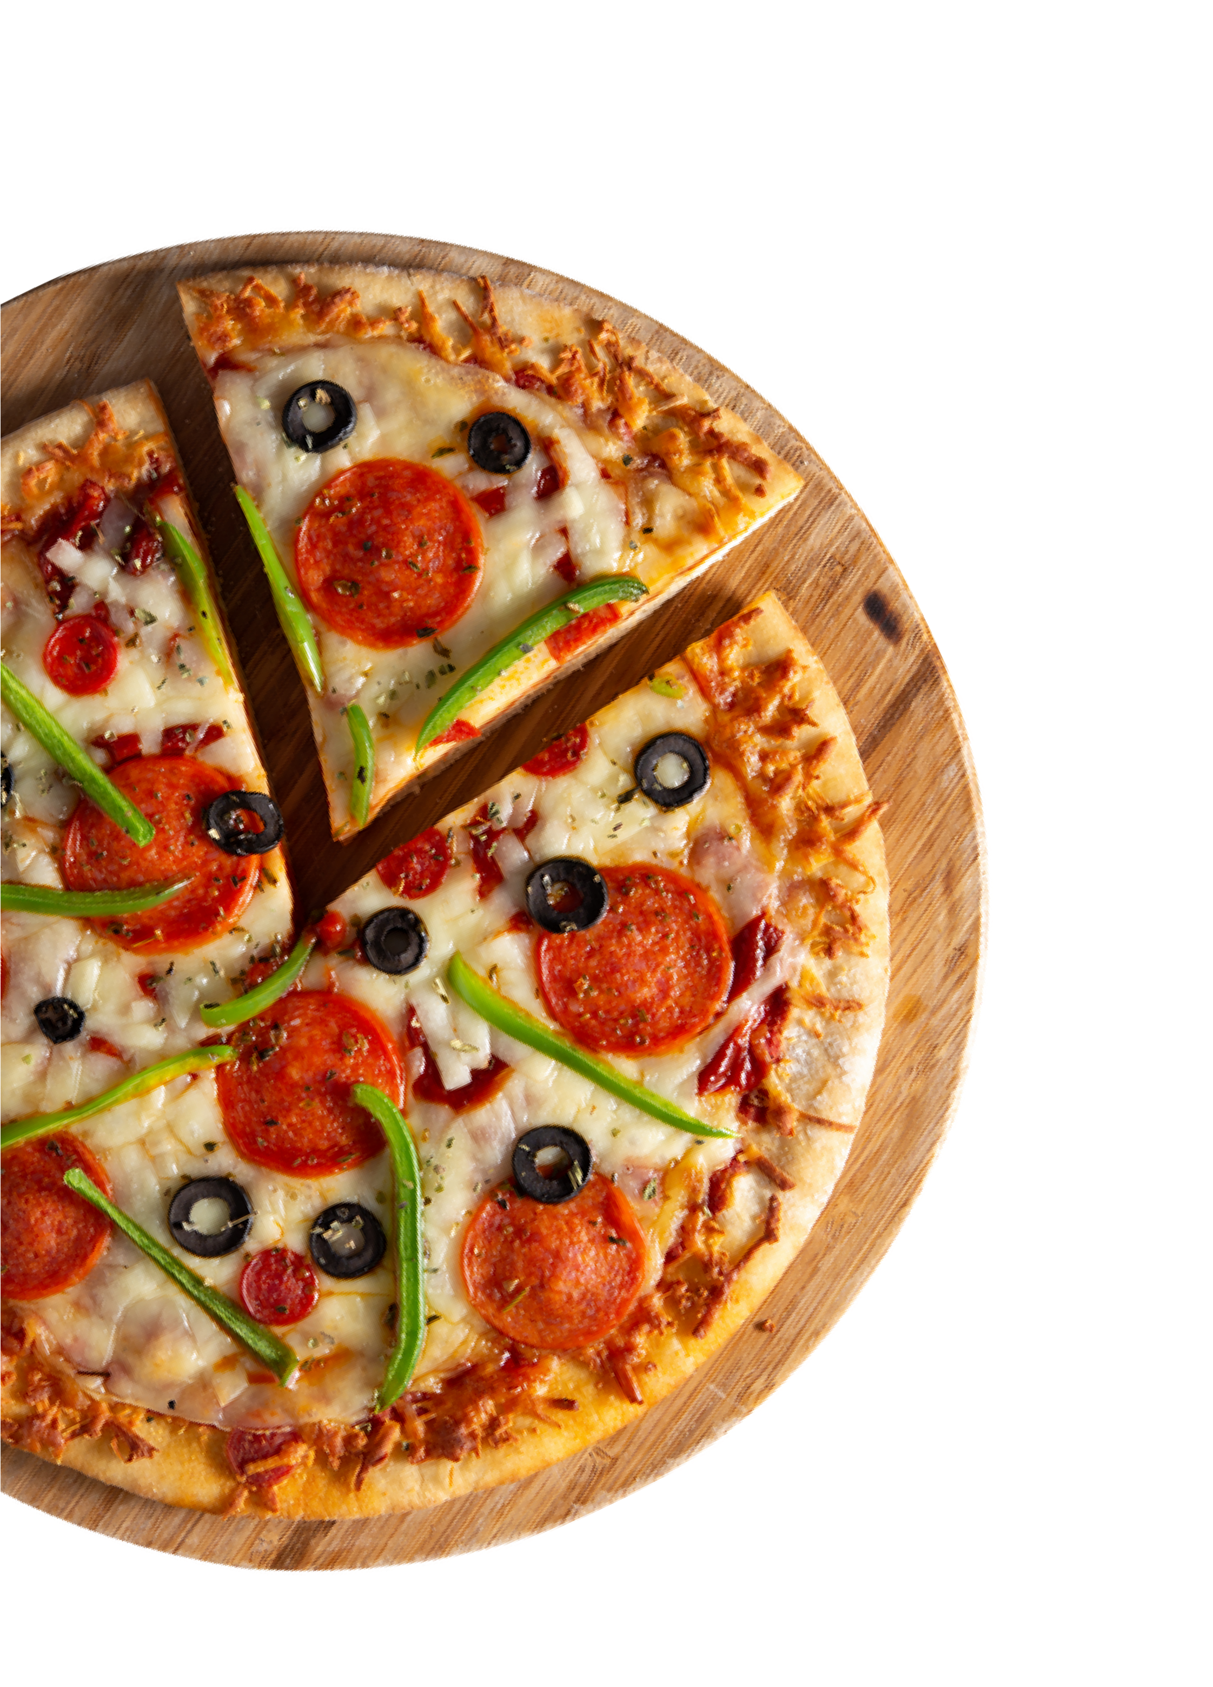
THANK YOU

